Slide 1

Ranchers.inc: A Business Report
Group Members
Muhammad Mufeez
Shayan Faisal
Kirsh Kumar
Hamza Ahmed
Sufyan Ali

Slide 2
Introduction
About Ranchers.inc
Ranchers.inc is a leading agricultural trading business committed to supplying farmers with high-quality seeds, fertilizers, pesticides, crops, and farm tools. Our extensive network allows us to provide competitive pricing and reliable delivery, catering to the diverse needs of various farming operations.

Slide 3
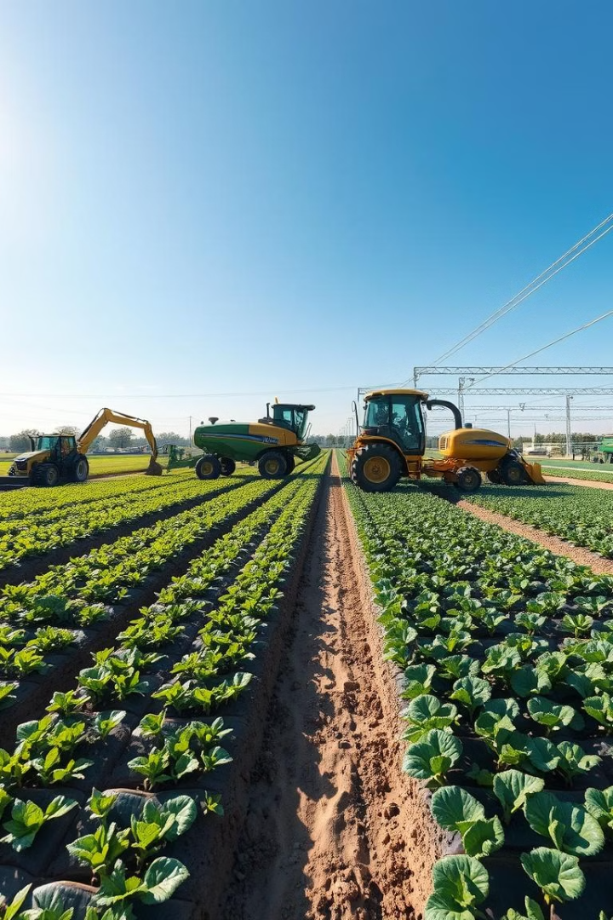
What We Offer:
Meat and Poultry
Dairy Products
Fresh Produce
Animal Products
Eggs

Slide 4
WHY CHOOSE US:
Organic and Sustainable
Farm to Table Approach
Versatility in Selling

Slide 5
LOCATION
Main Korangi road , near iqra university , shop no : 12C
Details
100 yards / 900 sq ft
front facing

Slide 6
Capital Budget Allocation
$150,000, Initial Investment
$117,600, Inventory Purchased
$1000, Rent Expense
$800, Utilities Expense
$2000, Wages Expense
121,400 → 28600 (remaining)
Our cost or expenses initially doesn't exceed the our investment.

Slide 7
Accounting Cycle: Perpetual System
Step 1: Transaction Occurs
1
A transaction, such as a sale or purchase, is recorded.
2
Step 2: Analyze and Record
Transactions are analyzed and recorded in the appropriate journals.
Step 3: Post to Ledger
3
Information from journals is transferred to the general ledger.
4
Step 4: Prepare Trial Balance
A trial balance is prepared to ensure the accounting equation is balanced.
Step 5: Prepare Adjusting Entries
5
Adjusting entries are made to ensure accuracy and reflect the correct financial picture.
6
Step 6: Prepare Adjusted Trial Balance
An adjusted trial balance is prepared after adjustments are made.
Step 7: Prepare Financial Statements
7
The financial statements are prepared based on the adjusted trial balance.

Slide 8
Financial Statements: Income Statement
Single Step Income Statement
Revenues
Net Sales
118,342
Total Revenue
118,342
Expenses
Cost Of Goods Sold
100,200
Operating Expenses
75,403
Interest Expense
23
Total Expense
175,626
Net Income
(57,284)

Slide 9





Financial Statements: Statement of Owner's Equity
Beginning Balance
1
$0
2
Net Income
$(57,000)
3
Owner Contributions
$150,000
4
Owner Withdrawals
$9,100
5
Ending Balance
$83,616

Slide 10
Financial Statements: Balance Sheet
Assets
1
Total Assets: $225,539
Liabilities
2
Total Liabilities: $141,923
Owner's Equity
3
Total Owner's Equity: $83,616

Slide 11

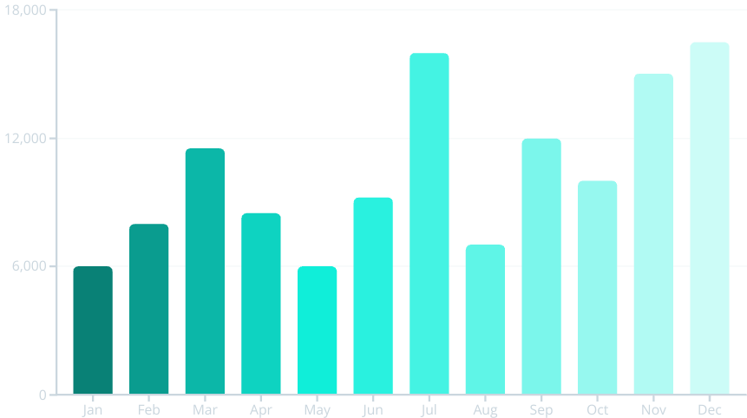
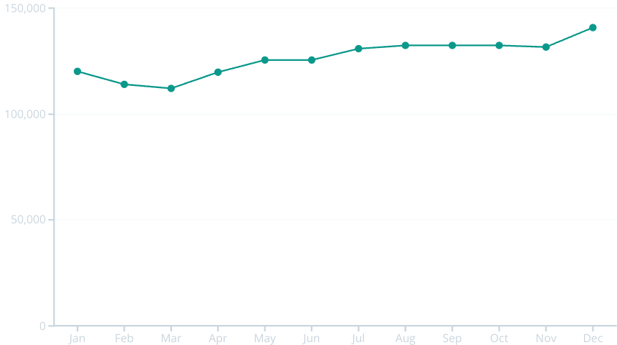
Monthly Growth Trends
Sales Revenue Growth
Payable Cash Growth
Sales revenue shows fluctuation throughout the year, with peaks in March, July, and December. While there is overall growth, consistent month-to-month increases are not observed.
Payable cash shows a general upward trend over the year, with some minor fluctuations. The increase suggests a positive cash flow and financial health.

Slide 12
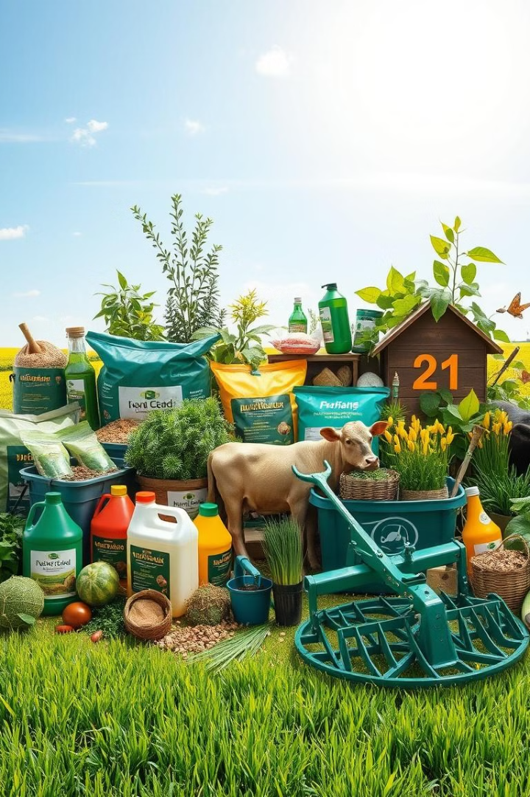
Conclusion: Looking Ahead
Ranchers.inc has established a strong foundation for continued success. The company will continue to prioritize customer satisfaction, product quality, and sustainable practices to maintain its leading position in the agricultural market.

Slide 13

THANKYOU

